Slide 1

Dynamical Diffraction
Manuel Sanchez del Rio

Slide 2
menu
Introduction
Diffraction: Kinematical and Dynamical
The formulations of dynamical diffraction
Undistorted crystals
Crystal reflectivities. Rocking curves
On the direction of diffracted wave. Implications
Crystals as phase retarders
Distorted crystals
Takagi-Taupin. Equations
Applications
Multiple beam diffraction
Applications in other fields; new applications
Final remarks

Slide 3
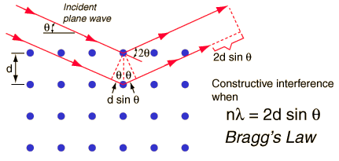
Diffraction
A result of COHERENT (RAYLEIGH) scattering of the X-rays on the elements of a periodic structure (e.g., atoms).
Although σ_{R} is small compared to other processes, the effect is the basis of X-ray diffraction.
The (small) scattering is enhanced by the periodic distribution of the scatterers (atoms)
Intensity
2θ

Slide 4
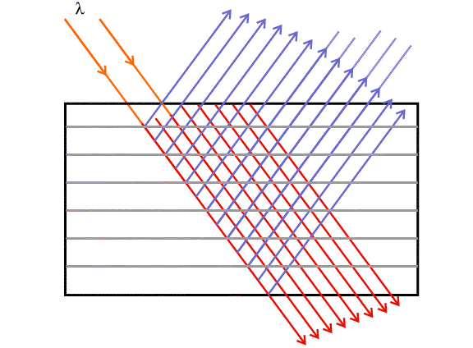
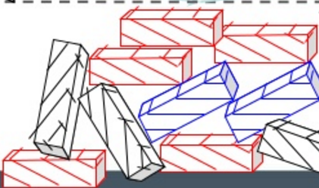
Kinematical vs dynamical diffraction
The diffraction of X-rays by very small crystals has been described by Laue's kinematic theory.
It supposes that oscillators in the crystal are only under the influence of the incident wave, neglecting the interaction between oscillators.
It can be applied to small crystals, like in powder diffraction.
For large crystals, the kinematical theory is no longer valid. This case is treated by the dynamical theory which includes multiple scattering of the radiation emitted by the oscillators and its interaction with the incident wave.

Slide 5
FORMULATIONS OF DYNAMICAL THEORY
Darwin (1914)The Theory of X-ray Reflexion Philosophical Magazine 27, 315
Ewald (1917) Zur Begründung der Kristalloptik, Teil III Die Kristalloptik der Röntgenstrahlen Ann. Phys. 54, 519
von Laue (1915) Die Theorie der Röntgenstrahlinterferenzen in neuer Form Encyclopaedie d. math Wiss 5,3, (1931) Ergebn. Exakt. Naturwiss.10133.
Zachariasen (1945) Theory of X-ray diffraction in crystals
James (1950) The optical principles of diffraction by X-rays
Taupin (1961) Théorie dynamique de la diffraction des rayons X par des cristaux déformés Bull Soc Fr. Mineral. 84 51
Takagi (1962) Dynamical theory of diffraction applicable to crystals with any kind of small distortion Acta Crystal 15 1311
Recent books:
Pinsker Dynamical Scattering of X rays in Crystals (1978).
Authier Dynamical Theory of X-Ray Diffraction (2001)
Shvyd’ko X-Ray Optics—High-Energy-Resolution Applications (2004)

Slide 6
Undistorted crystals

Slide 7
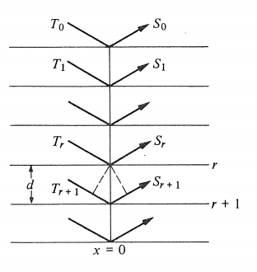
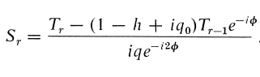
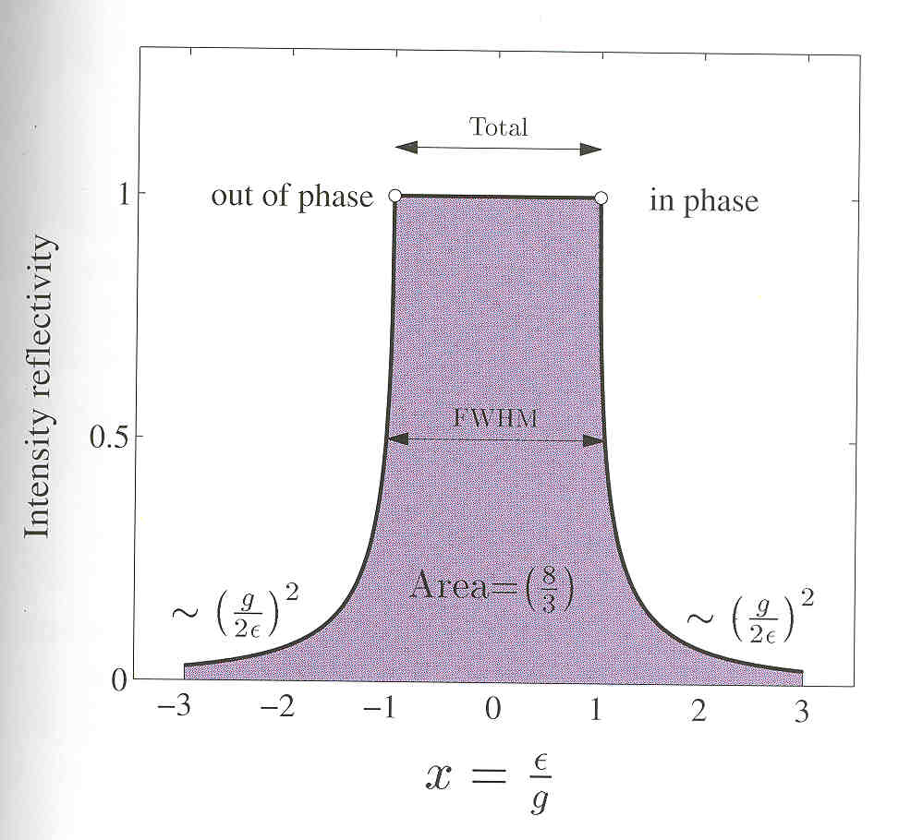
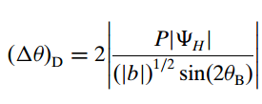
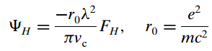
DARWIN TREATMENT OF DYNAMICAL THEORY (1914) – the darwin width

Slide 8
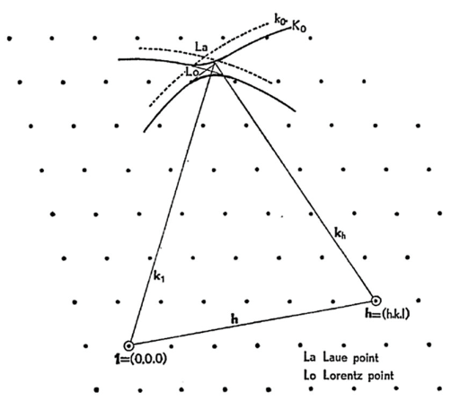
More RIGOROUS FORMALISMS (e.g., ZACHARIASEN’S BOOK)
Starting from Maxwell equation -> Wave equation -> Helmholtz equation
in crystal medium Electric susceptibility is expanded in Fourier series. Only two components or “beams” are usually considered
Two coupled equations (like TT)
Non trivial solution if the determinant vanishes (dispersion surface)
There is a general solutions for plane parallel crystals.
Implemented in XOP (inpro, crystal) and other codes

Slide 9
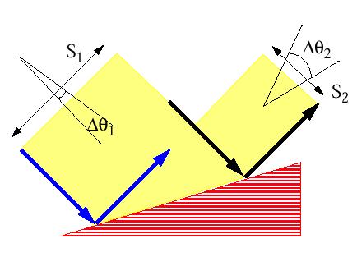
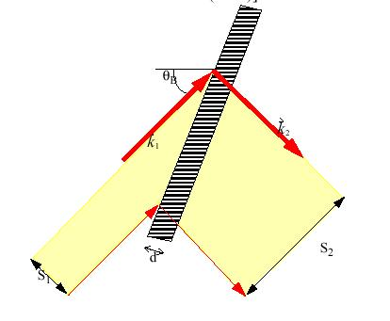
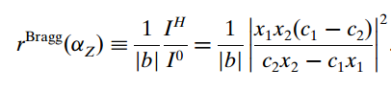
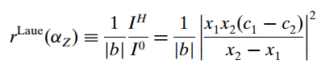
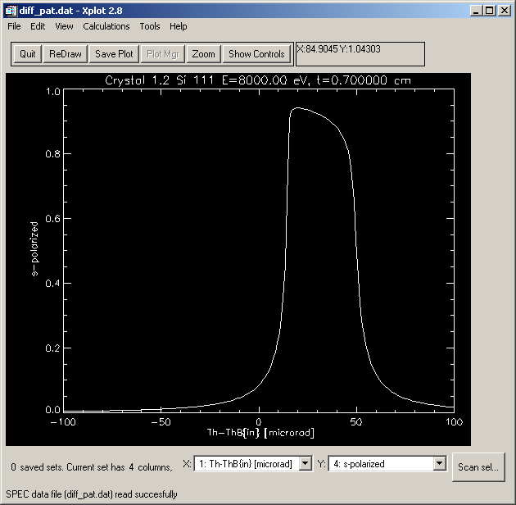
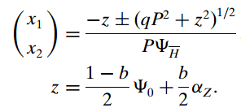
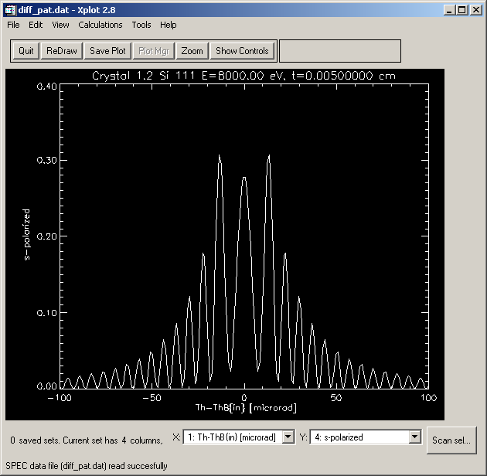
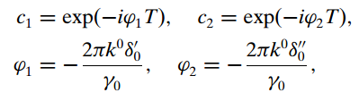
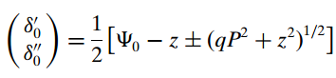
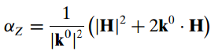
The Zachariasen treatment for plane Crystals
BRAGG or reflection
LAUE or transmission

Slide 10
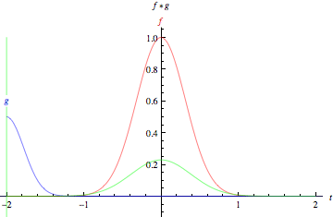
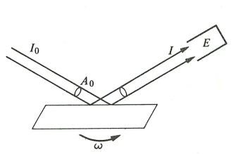
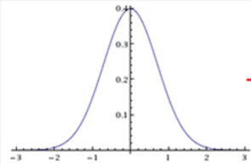
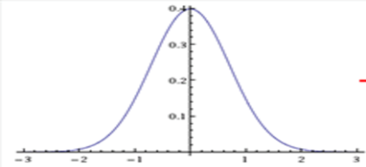

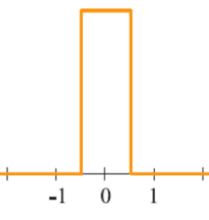
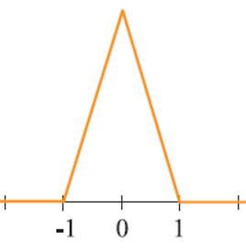
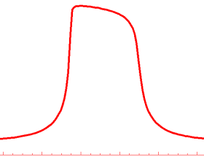
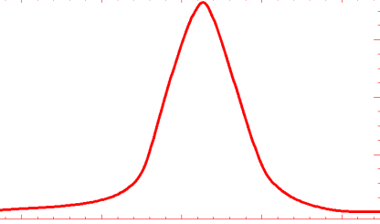
ROCKING CURVES
The rocking curve is the CONVOLUTION of the two diffraction profiles.
=
FWHM_{R} = 1.4 FWHM₁
=
FWHM_{R} = 1 FWHM₁
=
FWHM_{R} ~ 1.5 FWHM₁
_{Si111 8 keV}
For a full discussion about rocking curves see: Masiello et al. J. Appl. Crystall. 47, 1304-1314 (2014)

Slide 11
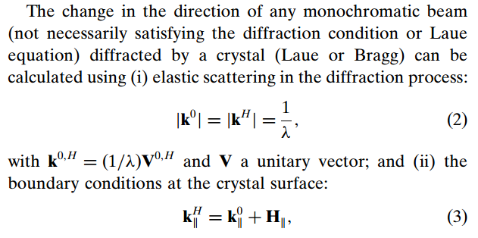
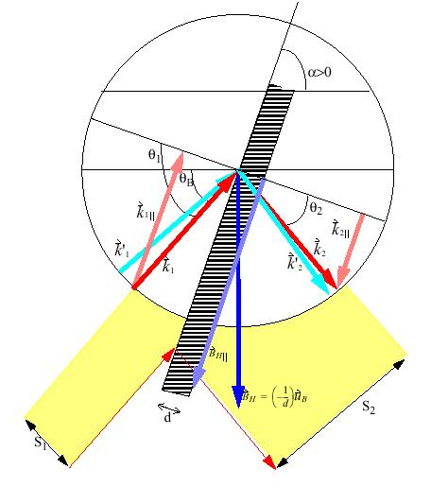
ON THE DIRECTION OF THE OUTCOMING WAVE
A crystal behaves like a grating or prism, except the Bragg Symmetric crystal that behaves like a mirror.
When combined with reflectivities from dynamical theory we can do ray tracing (beam decomposed in plane waves)

Slide 12
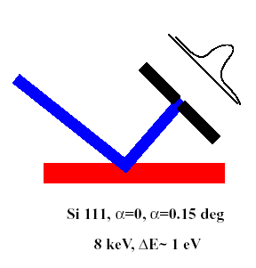
Consequences
Asymmetric Bragg & every Laue crystals are dispersive elements (X-rays with different energies will exit in different directions)
Bragg symmetric crystals are non-dispersive
They modify the divergence of the beam. It must be taken into account when combined with other focusing elements
Reduce visibility of diffraction patterns by coherent light
8000.0 eV
8000.5 eV
α=0
α=0.15

Slide 13
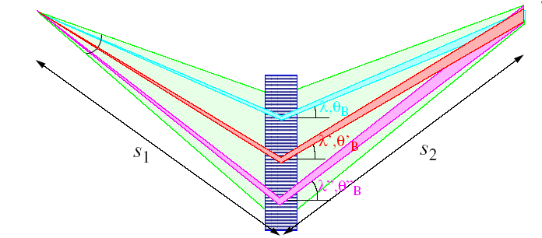
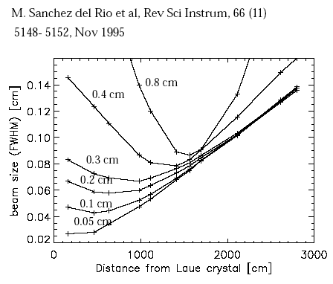
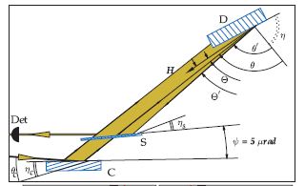
3) Polychromatic focusing with flat Laue crystals is fake focusing
4) Extreme asymmetry (backscattering) produces a rainbow effect Shvyd’ko 2006 PRL 97, 235502

Slide 14
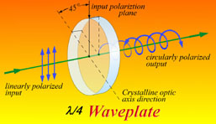
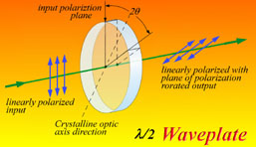
Crystal phase retarders
R
R
BRAGG
T
LAUE
T
Perfect crystals are birefringent elements: R_{σ} ≠ R_{π}
They introduce a phase change Φ that alter the polarization of the beam

Slide 15
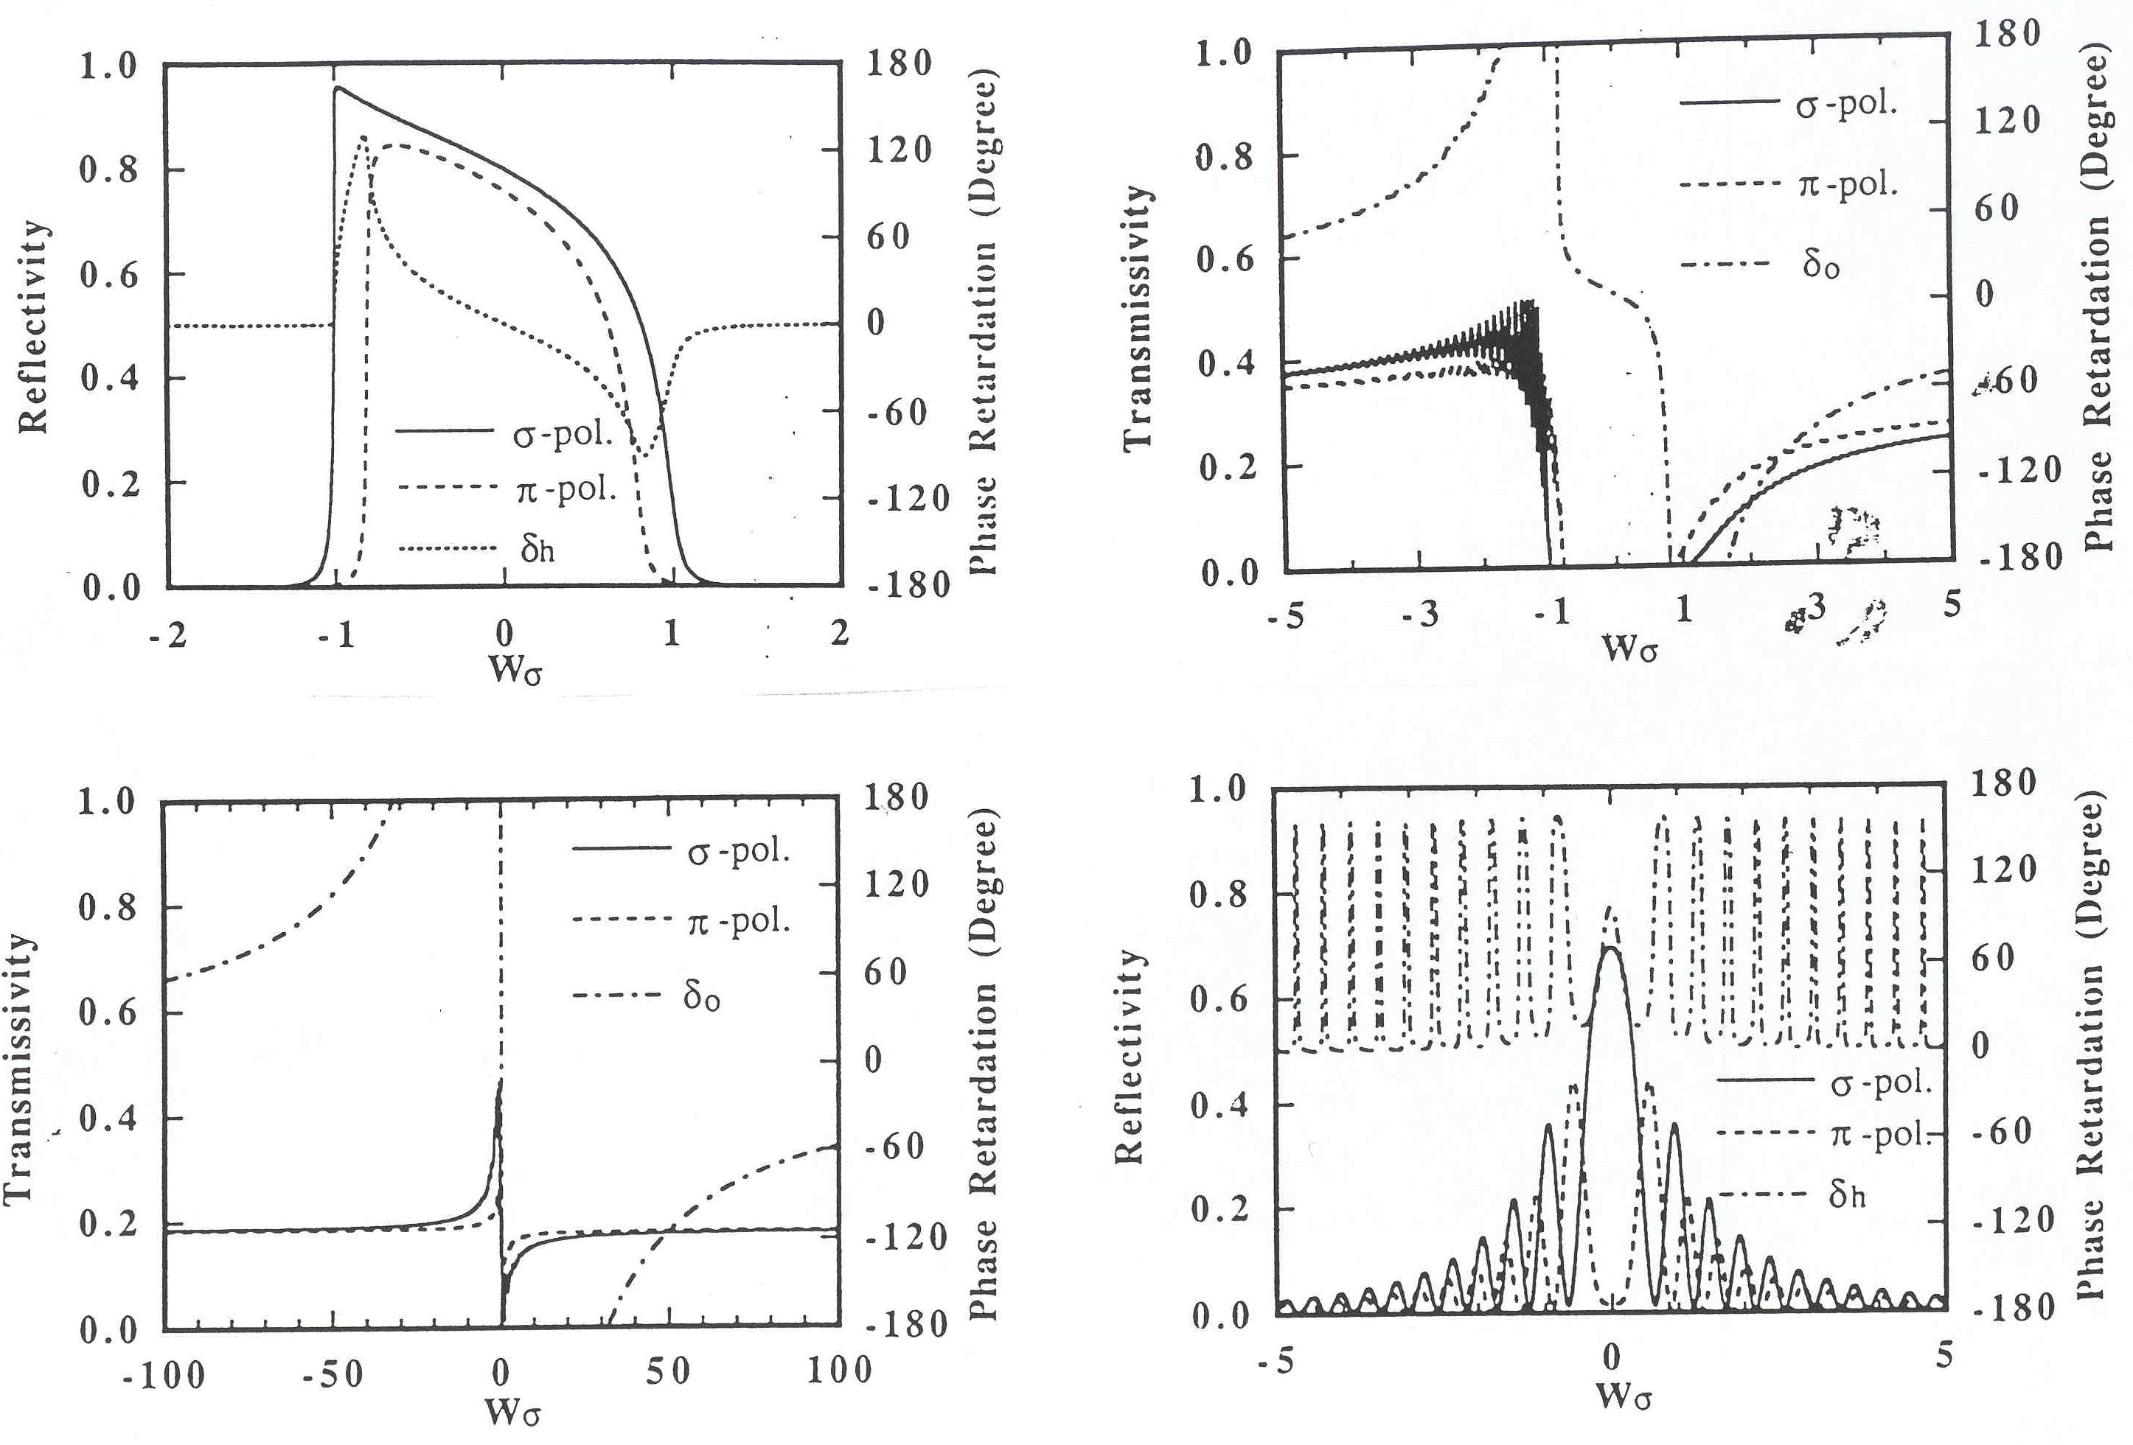
Change of phase
4XGe220
50μm Si220
Hirano et al., NIM A336 (1993) 343
22 μm C* 220
22 μm C* 220

Slide 16
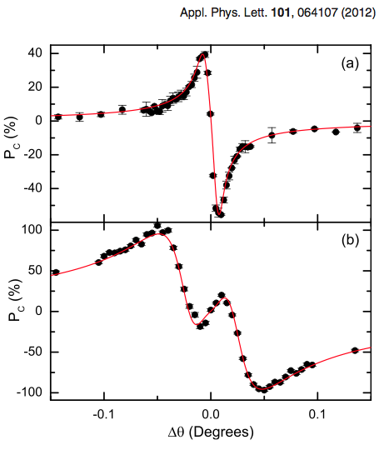
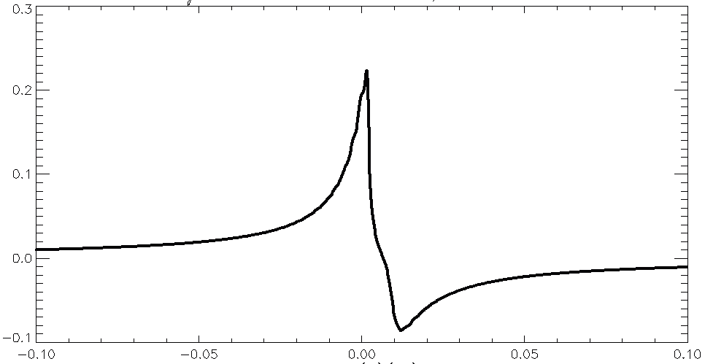
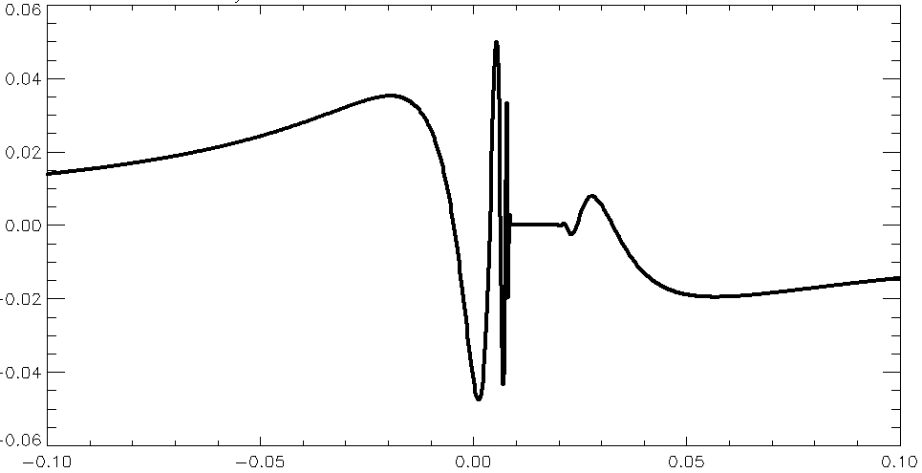
Circular polarization
Bouchenoire, Morris, Hase
Pc = r_{s} r_{p} sin (φ_{p} - φ_{s})
XOP
Si111 5μm
C*111 128μm
E=3.174 keV

Slide 17
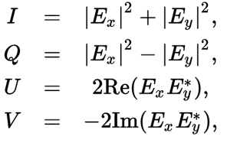
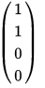
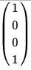
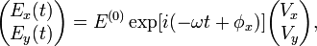
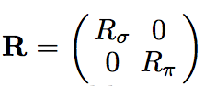
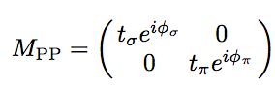
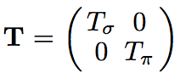
From jones to STOKES-MULLER FORMALISM (master PROJECT EDOARDO CAPPELLI)
Jones Matrices
P_{c}=-sinΦ if α=45 deg and a=1.

Slide 18
Distorted crystals

Slide 19
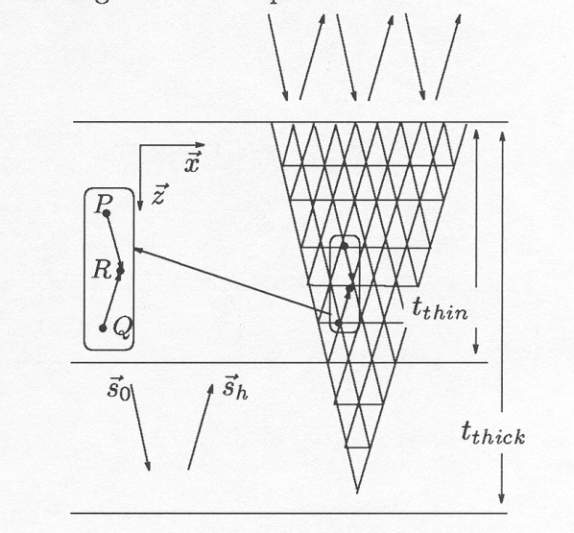
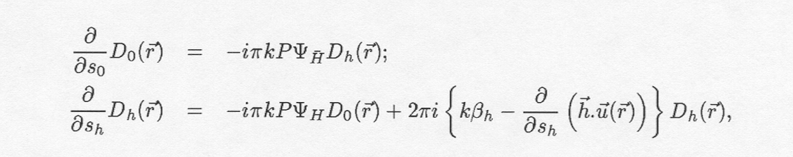
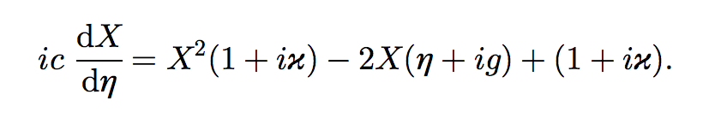
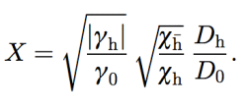

Takagi-Taupin (distorted crystals)
Takagi, Acta Crystal 15 (1962) 1311
Taupin, Bull Soc Fr. Mineral. 84 (1961) 51
Analytical solutions of Takagi-Taupin (TT) only fow a few cases
Numerical integration of the PDF (2D)
X-ray diffraction topography
If deformation u(z) (e.g., uniform curvature) the PDEs reduce to a single ODE

Slide 20



Using Dynamical theory in x-ray TECHNIQUES
X-ray standing waves
X-ray topography
Grazing incidence diffraction
The angles involved are close to the critical angle. Fresnel specular theory predicts an evanescent wave, which must be treated by the dynamical theory.
S. Stepanov
http://x-server.gmca.aps.anl.gov/
The fluorescence signal is directly proportional to the internal wave field intensity at the atom position . The position of the fluorescing atom with respect to the diffraction plane can be determined.
Batterman and Cole. Rev. Mod. Phys. 36 (1964) 681
Simulation of dislocations, stacking faults, cracks, etc.
Y. Epelboin, Progress in Crystal Growth and Characterization, 14, (1987 )465
Notes:
20

Slide 21



Using Dynamical theory in x-ray INSTRUMENTS
Curved spectrometers, monochromators and analyzers
Thermally deformed
monochromator
M. Krisch, Ph. Thesis (1993)
Hölzer et al. Cryst. Res. Technol. 33, 555 (1998)
Honkanen et al. J. Synchrotron Rad. 21, 104 (2014)
M. Sanchez del Rio et al. J. Synchrotron Rad.48, 477 (2015)
Mocella et al. Nucl. Inst. Meth. in Phys. Res. A 467, 414 (2001).
Mocella et al. J. Appl. Cryst. 36, 129 (2003)
Mocella et al. Proc. SPIE 9510 (2015) Honkanen, et al. J. Appl. Cryst. 49, 1284 (2016)
Surface acoustic waves
Monochromator+Analyzer in Diffraction Enhanced Imaging
m=-1
m=0
X-ray source
m=+1
θ
B
IDT
SAW
Bravin et al.
J. Appl. Phys. 97, 113505 (2005)
Mocella & Epelboin J. Appl. Cryst. 32, 154, 1999
Touculou et al . J. Appl. Phys. 97, 113505, 2005
Notes:
21

Slide 22






EFFECT OF CRYSTAL ANISOTROPY in bent crystals
111
11-2 or 1-10
M. Sanchez del Rio, N. Perez-Bocanegra, X. Shi & V. Honkimaki, J. Appl. Cryst. (2015). 48, 477-491

Slide 23
Multiple diffraction

Slide 24



Multiple BRAGG Diffraction
Simultaneous multiple diffraction occurs when the incident wave finds several sets of planes satisfying the Bragg law.
They were first discovered by Renninger (1937) so they are called Renninger reflections of detour reflections (umweganregung).
Kinematical theory (Cole, Acta Cryst.15 138 (1962); Rossmanith PSILAM; XOP/MARE)
Beyond kinematical theory (Colella, Acta Cryst. A30, 413 (1974); Shen; Stepanov http://x-server.gmca.aps.anl.gov)

Slide 25






Slide 26




OTHER APPLICATIONS
Other devices that exhibit strong dynamic diffraction properties can also be described using dynamical diffraction theory.
Multilayers/Superlattices
Fresnel Zone Plates
Bartels et al. Acta Cryst. (1986). A42, 539-545
Osterhoff, Opt. Lett. 37, 3705-3707 (2012).
http://x-server.gmca.aps.anl.gov/GID_sl.html
Yan et al Phys. Rev. B 76, 115438 (2007)
Dynamical diffraction is also of great importance in the fields of Neutron diffraction and Electron diffraction.

Slide 27
Some new applications of the Dynamical Theory of Diffraction

Slide 28



BERRY PHASE induces a kick of the x-ray trajectory
Berry, M.V. Proc. R. Soc. London, Ser. A392, 45 (1984)
Berry, M.V. 1990 Physics Today, 43, 12 34-40
K Sawada, S Murakami, N Nagaosa
Phys. Rev. Lett. 96, 154802 (2006)
Y Kohmura, K Sawada, T Ishikawa
Phys. Rev. Lett. 104, 244801 (2010)

Slide 29





Time-dependent diffraction
Time-dependence diffraction was studied in the 1990s
“wake” monochromator proposed by G.Geloni
G. Geloni Self-seeded X-ray Free-Electron Lasers
https://pubdb.xfel.eu/record/292720/files/RESUB_self_final%20-%20POST_REFEREE.pdf?subformat=pdfa
Y. Shvyd’ko and R. Lindberg, Spatiotemporal response of crystals in x-ray Bragg diffraction, Phys. Rev. ST Accel. Beams 15, 100702 (2012) dx.doi.org/10.1103/PhysRevSTAB.15.100702

Slide 30
Final remarks

Slide 31

WHICH MODEL SHOULD I USE?
Hierarchy of dynamical theories of x-ray diffraction for deformed and perfect crystals
J Härtwig (2001 J. Phys. D 34 A70)
1st approximation: dynamical diffraction theory for the perfect crystal
e.g, flat monochromators, curved monochromators and spectrometers locally “undistorted”, standing waves, etc. XOP, SHADOW
2nd approximation: local applications of the dynamical theory for perfect crystals to distorted ones
e.g, curved crystals: Multilamellar method (XOP/XCRYSTAL)
3rd approximation: geometrical optics or eikonal theory
e.g, curved Laue crystals: Penning-Polder method (XOP/XCRYSTAL)
4th approximation: wave optics or Takagi theory
2D numerical integration: Topography codes adapted to user needs.
1D numerical integration: curved spectrometers, monochromators, analyzers
5th approximation: wave optics or Takagi theory for many waves (white beams, curved surfaces, incoherent superposition, divergent beams)
TO DO

Slide 32

THE END
Thanks!

Slide 33
FigureS credits
http://x-server.gmca.aps.anl.gov/
http://staff.chess.cornell.edu/~shen/AEP711_Dynamical_XRD.pdf
https://hal.archives-ouvertes.fr/medihal-01285374/
Osterhoff, Opt. Lett. 37, 3705-3707 (2012)
ftp://ftp.ill.eu/pub/lss/Ekater/articles/r10901.pdf
M Krisch Ph D Thesis
Als-Nielsen & McMorrow “Elements of modern X-ray Physics”
http://www.u-oplaz.com/new/waveplate.htm

